Slide 1
Module 3 Linux Environments

Slide 2
Course Layout – Hacking 300
Lesson 1 – Introduction to Enterprise Networks Lesson 2 – Windows Domains and Active Directory Lesson 3 - Linux Networks
Lesson 4 – Kerberos Fundamentals
Lesson 5 – Attacking Domain Environments
Lesson 6 – CTF Start Lesson 7 – CTF Q&A
Lesson 8 – CTF Q&A Lesson 9 – CTF Q&A
Lesson 10 - Outbrief and Course Conclusion
← Today
Real-world systems: ethical hacking practicum – UW Summer 2021

Slide 3
Objectives
Understand the Linux security model
Users
Permissions
Capabilities
SUID/SGID
Linux Security Modules
Understand security concerns in real-world Linux deployments
Samba
OpenLDAP
SSH from a red teamer’s perspective
Where to look for credentials
SSH PAM

Slide 4

Philosophy: Linux vs Windows
Windows
Aims to be an end-to-end, full stack solution
There is an intended/supported way to do things
Not designed to pick and choose components or swap pieces out
Software not supposed to be modified/customized
Proprietary, (mostly) not open source
Costs money for licenses (mostly)

Slide 5

Philosophy: Linux vs Windows
Linux
Modular design, collection of tools/modules to pick and choose from
Free and Open Source Software
Plusses and minuses here - discuss
Customize and rebuild to fit your needs

Slide 6
Linux Network Environments
Based on the philosophy, what should we expect to see in a Linux network?

Slide 7
Linux Network Environments
Based on the philosophy, what should we expect to see in a Linux network?
Multiple tools to choose from for the same purpose
Systemd vs init.d controversy
List of init systems
Cheatsheet
Customized environments
Much more variable compared to Active Directory
Across the entire stack, you're likely to see many different combinations of software
Notes:
init is a abbreviation for Initialization.
init is a daemon process which starts as soon as the computer starts and continue running till, it is shutdown.
init is the first process that starts when a computer boots, making it the parent of all other running processes directly or indirectly and hence typically it is assigned “pid=1“.
If somehow init daemon could not start, no process will be started and the system will reach a stage called “Kernel Panic“.
Other alternatives
Upstart – A init replacement daemon implemented in Ubuntu GNU/Linux and designed to start process asynchronously.
Epoch – A init replacement daemon built around simplicity and service management, designed to start process single-threaded.
Mudar – A init replacement daemon written in Python, implemented on Pardus GNU/Linux and designed to start process asynchronously.
systemd – A init replacement daemon designed to start process in parallel, implemented in a number of standard distribution – Fedora, OpenSuSE, Arch, RHEL, CentOS, etc.
systemd is the parent of all other processes directly or indirectly and is the first process that starts at boot hence typically assigned a “pid=1“.
background processes which is designed to start processes in parallel, thus reducing the boot time and computational overhead.

Slide 8
Linux Security Model
Built-in users
Root
Others likely, distro specific
Root is highest privilege user on a system
In most cases day to day operations should not be run under this user
Some distros (Ubuntu) lock root out by default
Instead, use “sudo” concept for actions requiring administrative privilege
All users in a machine are listed in /etc/passwd
Groups are listed in /etc/group

Slide 9
Linux Security Model
File permissions
Every file has permissions for 3 main entities
Owning User (U)
User ID that owns the file
Owning Group (G)
Group that owns the file
World / “Other” users (O)
Any user that is not the owning User or in the owning Group
Usually represented like this
-rwxrwxrwx (file) drwxrwxrwx (directory) Enumerate this with `ls –l`
●
●

Slide 10
Linux Security Model
Working with permissions
chmod (change mode) command to change permissions
chmod u+w install_script
chmod o+rx install_script
chmod o-rwx install_script
Numeric representation
3 bits – R W X
R-X = 101 in binary = 5
RWX = 111 in binary = 7
`chmod 775 install_script`
– -rwxrwxr-x

Slide 11
Linux Security Model
`chown` (change owner)
Change ownership
SUID
Set user owner ID on execution
Any time this file is executed, run it as the owner user, instead of the identity that launched it
-rwsrwxr--
Numeric: 4774
SGID
Same as SUID, but for the owning group field

Slide 12
Linux Security Model
sudo - “super user do”
Allows running commands as another user
Approved accounts and settings are stored in /etc/sudoers
Administrative commands look like this
sudo apt-get install openssh-server
Whereas root user would just run:
apt-get install openssh-server

Slide 13
Linux Security Model
Capabilities
Similar to 'privileges' in Windows
Kernel does not check capabilities for root
All other users are checked for capabilities
Examples:
Bind a socket below port 1024
Block system suspend – prevent shutdown Bypass read file permissions
Change the owner of files
●
●
●
Full reference: https://man7.org/linux/man- pages/man7/capabilities.7.html
https://linux-audit.com/linux-capabilities-101/

Slide 14
Linux Security Model
Linux Security Modules (LSM)
Allow swapping out different security systems/models
Framework provides 'hooks' in the OS
Any time a sensitive operation is about to happen, LSMs are given the opportunity to do their own check and determine whether the action is allowed or not
Popular examples are AppArmor and SELinux

Slide 15

Linux Security Model
SELinux
Based on work by NSA and DoD
Allows separation of privilege and security policy enforcement
Partition services so compromise of one does not mean
compromise of entire system
Mashup of security models (RBAC, integrity controls, ACLs)
Somewhat complicated to set up
A lot of control available
When properly configured can provide extremely strong security

Slide 16
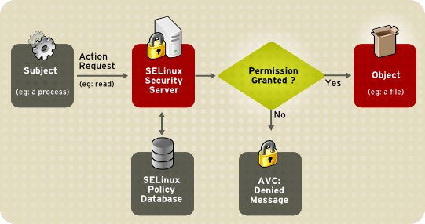
Linux Security Model
SELinux
Decent explanation
Notes:
SELinux provides a flexible Mandatory Access Control (MAC) system built into the Linux kernel.
Under standard Linux Discretionary Access Control (DAC), an application or process running as a user (UID or SUID) has the user's permissions to objects such as files, sockets, and other processes.
Subject - When a subject, (for example, an application), attempts to access an object (for example, a file),
policy “enforcement server” in the kernel checks an access vector cache (AVC), where subject and object permissions are cached.
Security sever- If a decision cannot be made based on data in the AVC, the request continues to the security server,
Security server looks up the ”security context” of the application and the file in a matrix.
Permission is then granted or denied, with an avc: denied message detailed in /var/log/messages if permission is denied.
The security context of subjects and objects is applied from the installed policy, which also provides the information to populate the security server's matrix.

Slide 17

Linux Security Model
AppArmor
Permissions based on “profiles”
Somewhat less complicated than SELinux
Similar controls to SELinux
A “profile” could allow or deny access to raw sockets, for example
File system permissions
Similar goal: restrict what software running on a machine can do

Slide 18
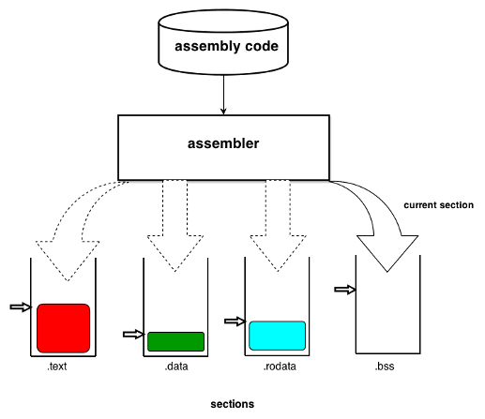
Linux Security Model
Bonus material
Zombie Ant Farm - Evading Linux EDRs (Endpoint Detection and Response)
Defcon 2019 recording
Slides
See the usage of OS hooks
Image taken from https://lwn.net/Articles/531148/
Notes:
Linux supports several binary file formats, ELF (Executable and Linking Format) is the preferred format since it is flexible and extensible by design
ELF binary files consist of an ELF header followed by a few segments, each segment has its own access rights.
linker merges together all sections of the same type included in the input object files into a single section and assigns an initial address to it.
Linking is the process of combining various pieces of code and data together to form a single executable that can be loaded in memory.
can be done at compile time, at load time (by loaders) and also at run time (by application programs).
There is the Compiler, Linker and Loader - https://www.linuxjournal.com/article/6463
Executable files include four main sections, .text, .data, .rodata, and .bss.
.text section contains executable code and is packed into a segment which has the read and execute access rights.
.data and .bss sections contain initialized and uninitialized data respectively, and are packed into a segment which has the read and write access rights.
Linux loads the .text section into memory only once, no matter how many times an application is loaded.
“Hooking” and example
When a “function” in the .text section is called, the instruction pointer jumps to the address of the first instruction of that function.
To “hook”/control such a function, the instruction pointer can be redirected to jump to the entry in the Procedure Linkage Table (PLT) of a shared library function which will be called instead.
The shared library function can then be overridden via LD_PRELOAD by injecting custom code to be executed in place of the hooked internal function.

Slide 19
Linux Security Model
Questions?

Slide 20

Linux Networks
Samba
An entire suite dedicated to interop with Windows platform/AD
Around since early 90s
SMB is a major part, but there's a lot more:
Windows DC on Linux
LDAP + Kerberos (Heimdal)
SAM/LSA
DCE/RPC/MSRPC/NetBIOS/WINS/...
Potentially have an AD environment without any actual Windows machines
Linux machines that integrate well with Active Directory
Notes:
Some samba.org “Since 1992, Samba has provided secure, stable and fast file and print services for all clients using the SMB/CIFS protocol”
Early on windows and unix ecosystems were much more separated
two systems come from very different cultures and communication and integrations is difficult, fixing this is Samba's job.
Samba runs on Unix platforms, but speaks to Windows clients like a native
All of this is managed through a protocol suite which is currently known as the "Common Internet File System", or CIFS.
This name was introduced by Microsoft, and provides some insight into their hopes for the future.
heart of CIFS is the Server Message Block (SMB) protocol
Samba is an open source CIFS implementation
Originally IBM and Sytec co-developed a simple networking system designed for building small LANs.
The system included NetBIOS, or Network Basic Input Output System.
NetBIOS was software that was loaded into memory to provide an interface between programs and the network hardware.
Microsoft added features to DOS that allowed disk I/O to be redirected to the NetBIOS interface, which made disk space sharable over the LAN.
The file-sharing protocol that they used eventually became known as SMB, and now CIFS.
Samba consists of two key programs, smbd and nmbd (and lots of other). They do the four main duties of CIFS services, which are:
File & print services
Authentication and Authorization
Name resolution
Service announcement (browsing)
More modern things samba can do that we care about, some examples
Samba-3 can replace an MS Windows NT4 domain controller.
Samba-3 offers excellent interoperability with MS Windows NT4-style domains as well as natively with Microsoft Active Directory domains.
Samba-3 permits full NT4-style interdomain trusts.
Samba-3 permits use of multiple concurrent account database backends. (Encrypted passwords that are stored in the account database are in formats that are unique to Windows networking).

Slide 21
Linux Networks
Samba security issues
Similar security issues as Microsoft's SMB implementations
Older versions (3.*) considered vulnerable
Insecure configurations (lack of signing, encryption) are always a problem
CVE-2016-2118 - Badlock vulnerability (April 2016)
MITM Elevation of Privilege / DoS
Both Samba and Windows affected
CVE-2017-7494 – upload shared lib to writable share and cause server to execute it
simple.create_pipe("/path/to/target.so")
SMB, Domain Controllers are high value targets regardless of the implementation (Samba vs MSFT)
Notes:
CVE-2016-2118 (bad lock vuln)
“caused by the way the SAM (security account manager) and LSAD (local security authority domain) remote protocols establish the Remote Procedure Call (RPC) channel.”
“A man in the middle can intercept any DCE/RPC (Distributed Computing Environment / Remote Procedure Calls) traffic between a client and a server in order to impersonate the client and get the same privileges as the authenticated user account. This is most problematic against active directory domain controllers.”
key factor in the exploitation of this vulnerability is the need for the attacker to carry out a man-in-the-middle (MitM) attack first.
after a successful attack, the attacker would gain elevation of privilege. With these elevated privileges, the attacker could gain access to SAM database which can be used to brute force the passwords from hashes.
CVE-2017-7494
released in April 2017 after being stolen from the NSA
bug causing this vulnerability is in the is_known_pipename() function
Dubbed ‘EternalRed’ by industry-types, this vulnerability dates as far as 2010.
upload shared lib to writable share and cause server to execute it
vulnerability is super simple to trigger this exploit. This one line of code executes malicious code on the affected system.
simple.create_pipe("/path/to/target.so")

Slide 22
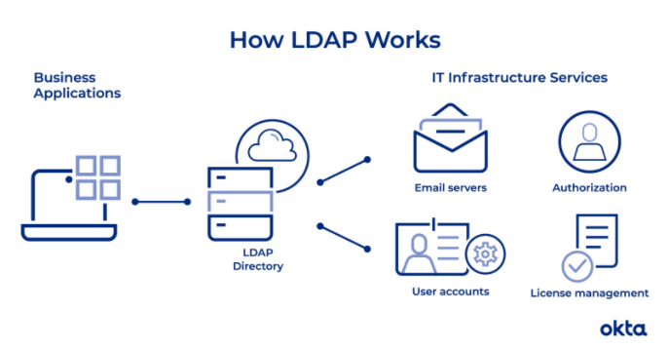
Linux Networks
LDAP Implementations
OpenLDAP
Open implementation of LDAP (surprise!)
Often used with Samba
389 Directory Server / Fedora Directory Server
RedHat
Comparison with OpenLDAP
OpenDJ/OpenDS
Java implementation
Probably many others
Same LDAP security issues we talked about in Lesson 1
Notes:
LDAP is a protocol, so it doesn't specify how directory programs work. Instead, it's a form of language that allows users to find the information they need very quickly.
Companies store usernames, passwords, email addresses, printer connections, and other static data within directories.
LDAP is an open, vendor-neutral application protocol for accessing and maintaining that data.
White paper for LDAP was originally published in 2003
While working at Sun Microsystems in 2003, Greg Lavender and Mark Wahl wrote a whitepaper providing an in-depth history of directory services, and a good technical overview of LDAP.
There are a variety of ways LDAP can be setup
I’ll provide a bit more clarity in the next couple slides based on feedback from the homework.

Slide 23
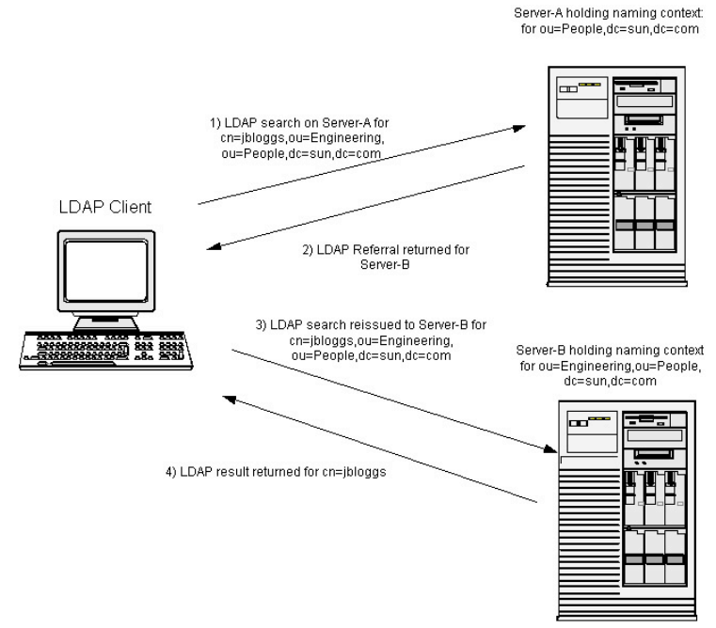
Linux Networks – LDAP Referral
Notes:
referral model situation, and assumes that a client is anonymous, such that it can bind and search any one of the two directory servers shown
if a client request an operation against one directory server (e.g., a search operation)
and that directory server does not hold the entry or entries that satisfy that operation,
then a referral may be returned to the client.
A referral is a list of LDAP URLs that point to other directory servers that the original server is configured to refer queries too.

Slide 24
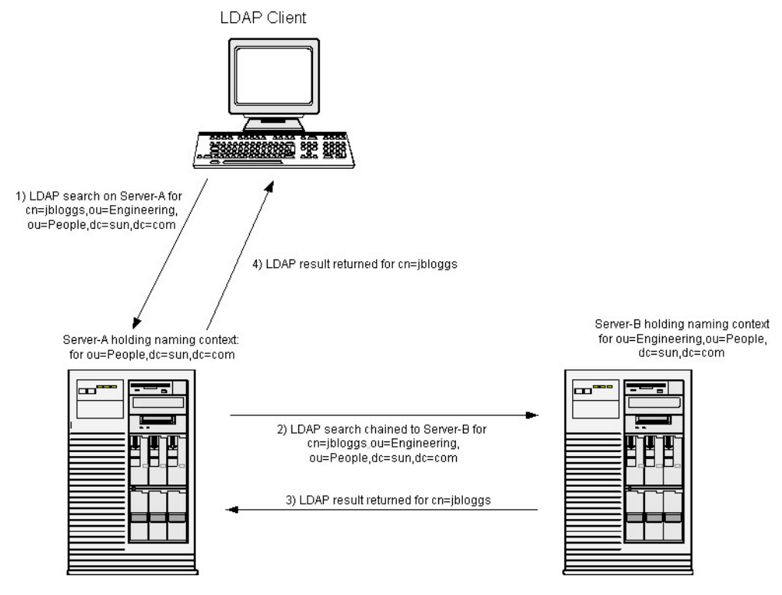
Linux Networks – LDAP Chaining
Notes:
chaining model is similar to the referral model, but provides a higher degree of security and administrative control.
a client issues a search request to Server-A,
which uses its knowledge of which server holds the subordinate naming context,
and it chains the request to Server-B.
Chaining assumes an implied trust model between Server-A and Server-B,
since typically Server-A will authenticate to Server-B as itself, not as the client.
For efficiency in the chaining model, it is typical for Server-A to maintain a persistent open network connection to Server-B to eliminate the overhead of binding for each chained operation.

Slide 25
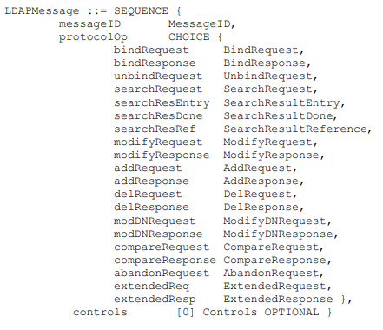
Linux Networks – LDAP Protocol
Notes:
LDAP really is a protocol
The details of the protocol are not what is important at this point in time - rfc2251
It can get confusing when people compare LDAP and Active Directory
LDAP provides the communication language that applications use to communicate with other directory services servers.
Directory services store the users, passwords, and computer accounts, and share that information with other entities on the network.
Active Directory is a directory services implementation that provides all sorts of functionality like authentication, group and user management, policy administration and more.
LDAP is a way of speaking to Active Directory.
Some people might say we don’t use Active Directory, we use LDAP.
What they probably mean is that they have another product, such as OpenLDAP, which is an LDAP server.
Looking at the “communication”, just like any other communication it has a defined protocol - rfc2251
An “LDAPMessage” is converted to bytes, and the resulting series of bytes is sent on the TCP connection.
At this time the only common fields are the message ID and the controls.
messageID, is distinct from that of any other message the client has recently sent on that connection, typically by incrementing a counter for each message.

Slide 26
Linux Networks – LDAP Authentication
(&(objectClass=user)(sAMAccountName=yourUserName) (memberof=CN=YourGroup,OU=Users,DC=YourDomain,DC=com))
Notes:
“LDAP query”
command that asks a directory service for some information.
E.g: which groups a particular user is a part of (the string in the slide is a query)
To access such information from the directory service you need to authenticate
2 options for LDAP authentication in LDAP v3
Simple - allows for three possible authentication mechanisms
Anonymous authentication: Grants client anonymous status to LDAP.
Unauthenticated authentication: For logging purposes only, should not grant access to a client.
Name/Password authentication: Grants access to the server based on the credentials supplied – should not be used without confidentiality protection.
SASL (Simple Authentication and Security Layer)
binds the LDAP server to another authentication mechanism, like Kerberos.
LDAP server uses the LDAP protocol to send an LDAP message to the other authorization service.
initiates a series of challenge response messages that result in either a successful authentication or a failure to authenticate.
NOTE: LDAP passes all of those messages in clear text by default!
Anyone on the network can sniff the packets, need to add TLS encryption

Slide 27
Linux Networks
SSH – Secure Shell
Remote shell software intended to be a step up from telnet and other plaintext protocols
Public key cryptography
Many uses
Securing insecure network protocols
Remote login to another machine
Used in all sorts of network software and distributed applications, e.g. git
Tunneling! https://www.howtogeek.com/168145/how-to-use-ssh-tunneling/
Just like Remote Desktop, SSH is a common target for attackers
Notes:
SSH, also known as Secure Shell or Secure Socket Shell, is a network protocol
refers both to the cryptographic network protocol and to the suite of utilities that implement that protocol
Supposed to give users a secure way to access a computer over an unsecured network
SSH uses the client-server model,
connecting a Secure Shell client application, which is the end where the session is displayed,
with an SSH server, which is the end where the session runs.
Leverages public key crptography

Slide 28
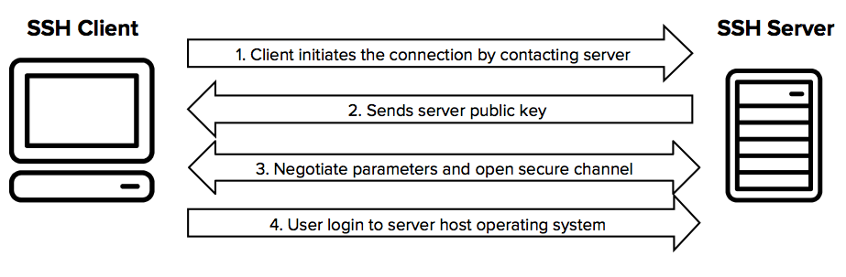
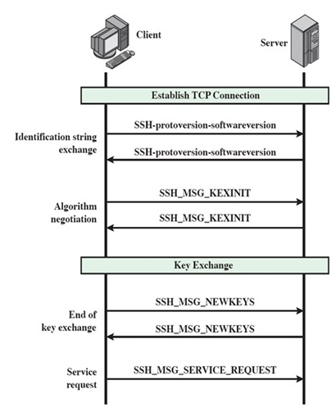
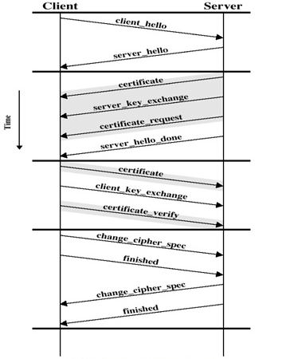
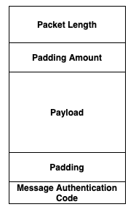
Linux Networks
Notes:
SSH protocol dictates a structure like TCP
Packet Length tells you how big the packet is.
Padding Amount, tells you how much padding there is.
Payload, the actual data
Padding, random bytes that don’t mean anything but are encrypted along with the payload to make it even harder to detect the data because you’ve thrown in this random extra data.
Message Authentication Code so that you can be sure the data has not been tampered with.
SSH uses three main concepts similar to a SSL handshake, although the steps are very different
Symmetrical Encryption
Asymmetrical Encryption
Hashing
SSH Handshake
Identification string exchange
To know which SSH version, which SSH implementation
Algorithm Negotiation
For the crypto algorithms (key exchange, encryption, MAC) and compression algo.
A list in the order of preference of the client
For each category, the algorithm chosen is the first algorithm on the client's list that is also supported by the server.
key exchange
Only two exchanges
Diffie-Hellman based
Also signed by the server (host private key)
As a result (i) two sides now share a master key K. (ii) the server has been authenticated to the client.
Then, encryption, MAC keys and IV are derived from the master key
End of key exchange
To signal the end of key exchange process
Encrypted and MACed using the new keys
Service Request: to initiate either user authentication or connection protocol

Slide 29
Linux Networks
SSH
Multiple authentication types
Password based
Not recommended – see these resources on the Mirai botnet
Certificate/key-pair based
Password-less
Kerberos/NTLM

Slide 30
Linux Networks
SSH
Fingerprints are important
Similar to a thumbprint for a certificate, they identify a unique public/private key pair
Uniquely identifies a host to a user when they log in
Prevents MITM attacks
In a perfect world where people check the fingerprint before logging in

Slide 31
Linux Networks
SSH
known_hosts file
Stores public keys of “known” or “approved” host machines along with other metadata
When connecting to a remote machine, the fingerprint it presents is checked against the known_hosts file
Default behavior is to ask the user if they recognize the fingerprint before logging in
This is very important for password-based auth. The remote host's fingerprint is the only proof that it is not a MITM attacker. If you don't check this and are using password auth, you are toast!

Slide 32
Linux Networks
SSH
StrictHostKeyChecking
This is a command line param and/or configuration file option with 3 possible values:
`Yes` – If the host key is not in known_hosts, bail out!
`Ask` – Default. If the host key is not in known_hosts, ask the user if they want to connect.
`No` – If the host key is not in known_hosts, add it to known hosts and don't ask the user about it. Connect anyway!
'No' + Password auth = “Please MITM every SSH connection from my machine from this point forward.”

Slide 33
Linux Networks
Why is `StrictHostKeyChecking=No` such a big deal?

Slide 34
Linux Networks
known_hosts is the list of trusted machines and
`StrictHostKeyChecking=no` automatically adds anyone you connect to to this list
This is a user-wide or possibly machine-wide setting!
Every future SSH connection will trust hosts on this list!
If using username/password, you send credentials to the remote machine encrypted with the public key they provided
MITM pretends to be your remote machine and steals your creds.
With clever relaying you might get a successful connection to your machine through the attacker and not know anything bad happened.
Ssh-mitm tool - https://github.com/jtesta/ssh-mitm
https://github.com/sarwarul/at/blob/master/mitm- ssh/README.mitm-ssh

Slide 35
Linux Networks
Why would anyone use StrictHostKeyChecking=No?
The default 'ask' mode requires user interaction
Scripts, software using ssh often don't handle the prompt
Developer's first instinct: “How can I make this go away?”
StackOverflow and other forums are full of people recommending 'No' and not understanding the implications
A better choice would be to add the known-good key of your remote host to known_hosts and then use 'Yes' to avoid the prompt.

Slide 36
Linux Networks
Why isn't certificate auth affected by StrictHostKeyChecking=No?
It turns out the Diffie-Hellman key exchange process breaks MITM relaying of cert-based SSH
https://www.gremwell.com/ssh-mitm-public-key-authentication
In the non-relay case, MITM doesn't get credentials because private key is never shared

Slide 37
Linux Networks
Where to look for credentials on a compromised machine?
~/.ssh/
~/.ssh/id_rsa
~/.ssh/id_rsa.pub
Profiles
~/.bashrc or ~/.zshrc
.bashprofile
.bash_history
Environment variables
Run `env`
/etc/passwd, /etc/shadow
Cloud instance metadata
AWS: https://docs.aws.amazon.com/AWSEC2/latest/UserGuide/instancedata-data-retrieval.html
GCP: https://cloud.google.com/compute/docs/storing-retrieving-metadata
Azure: https://docs.microsoft.com/en-us/azure/virtual-machines/windows/instance-metadata-service
Look for other clues, including public key files for other machines in the environment
Check /etc/ssh for SSH config files for more clues about how SSH is configured in the environment
Use acquired private key to try SSH to other machines
Get past fingerprint whitelisting (only accept connections from certain public keys)

Slide 38
Linux Networks
PAM – Pluggable Authentication Modules
Easily swap out different types of authentication
Each module implements some kind of authn
High level software doesn't have to worry about auth specfiics
A number of popular auth schemes supported
Notes:
https://access.redhat.com/documentation/en-us/red_hat_enterprise_linux/7/html/system-level_authentication_guide/pluggable_authentication_modules
Pluggable Authentication Modules (PAMs) provide a centralized authentication mechanism which system application can use to relay authentication to a centrally configured framework.
pluggable because there is a PAM module for different types of authentication sources (such as Kerberos, SSSD, NIS, or the local file system).
integrates multiple low-level authentication modules into a high-level API that provides dynamic authentication support for applications.
allows developers to write applications that require authentication, independently of the underlying authentication system.
To use PAM, an application/program needs to be “PAM aware“; it needs to have been written and compiled specifically to use PAM.
admin can configure PAM configuration file(s) that define the connection between applications (services) and the pluggable authentication modules (PAMs) that perform the actual authentication tasks.
Putting it all together, for example
configure NSS
NSS (which stands for Name Service Switch) is a system mechanism to configure different sources for common configuration databases. For example, /etc/passwd is a file type source for the passwd database.
to use the OpenLDAP server as a source for the passwd, shadow and other configuration databases and
then configure PAM to use these sources to authenticate its users.

Slide 39
Linux Networks
PAM examples
pam_unix
Default that implements behavior we talked about previously (/etc/passwd, /etc/shadow)
Configurable, for example change hash algorithm
pam_ldap
One way to integrate workstation logon with LDAP
pam_unix can also do LDAP with some configuration
pam_krb5
Kerberos V5, can build against Heimdal or MIT implementations
Somewhat limited in capability from my understanding (aimed at initial workstation logon flow)

Slide 40
Linux Networks
Big Data technologies
We’ve covered Hadoop and related tech before
Even if the overall network is not heavy on Linux, you’re likely to see big data technology running on Linux
Possibly integrated with AD or Kerberos
Or maybe standalone environments/clusters
Examine these carefully for misconfiguration
Not well understood by a lot of admins or devs/data scientists
People want SSO but won’t necessarily take the time to set it up securely!
Compromise of a poorly secured Linux cluster might be your ticket into the domain

Slide 41
Linux Networks
Thinking about attacking networks
Organize your thoughts
What are you attacking?
Notice all the access controls are a long chain of events
Each step/component has its own unique tasks
Then we try and connect them all together into a logical flow
Where are the gaps?
Class Question - Based on what we have covered so far what are examples of these?
What are you attacking?
The individual step/component
The linking between them
Where are the gaps?

Slide 42
Linux Networks
Questions?

